Slide 1

UNIT#2 ACTIVITY PLANNING & SCHEDULING

Slide 2
Activity Planning
Means for evaluating the consequences of not meeting any of the activity target dates
Guidance as to how the plan might most effectively be modified to bring the project back to target
Objectives of Activity Planning
Feasibility Assessment
Resource Allocation
Detailed Costing
Motivation
Co-ordination

Slide 3
Project Schedule
Before work commences on a project, the project plan must be developed to the level of showing dates when each activity should start and finish and when and how much of each resource will be required
Project Schedule Comprises of 4 Stages
Creating an Activity Plan
Activity Risk Analysis
Resource Allocation
Schedule Production

Slide 4
Project and Activities: Defining Activities
A project if composed of number of inter-related activities
A project may start when at least one of its activities is ready to start
A project will be completed when all of its activities it encompasses have been completed
An activity must have a clearly defined start and end point marked by the production of tangible deliverable
The duration of an activity must be forecastable
Some activities might require that other are completed before they can begin
Activities must be defined so that they meet these criteria and any activities failing to meet these criteria must be redefined

Slide 5
Project and Activities: Identifying Activities
Three approaches to identifying activities that makeup a project
Activity Based Approach
Product Based Approach
Hybrid Approach

Slide 6
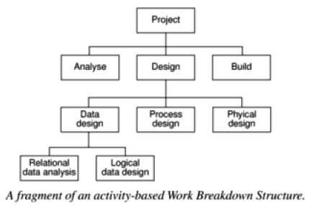
Activity Based Approach
Consists of creating a list of all activities that the project is thought to involve
Brainstorming session with the whole project team
Work Breakdown Structure (WBS) becomes handy

Slide 7
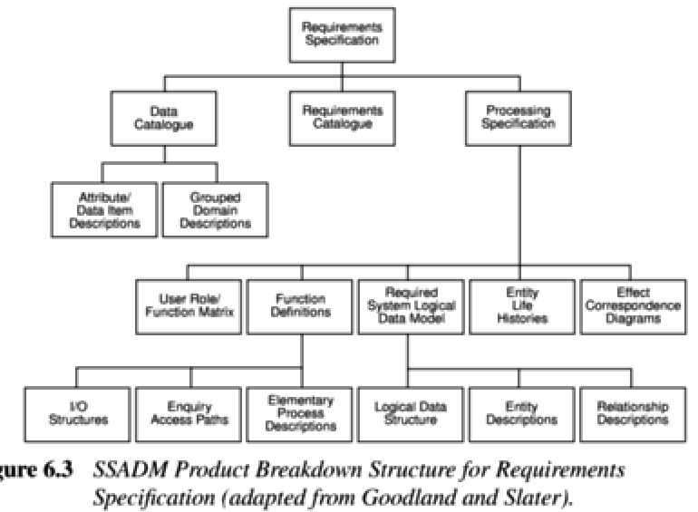
Product Based Approach
Consists of Product Breakdown Structure (PBS) and Product Flow Diagram (PFD)
PFD indicates for each product which other products are required as inputs

Slide 8
Hybrid Approach
IBM recommended 5 levels in WBS
Level 1: Project
Level 2: Deliverables such as software, manuals and training courses
Level 3: Components which are the key work items needed to produce deliverables such as the modules and tests required to produce the system software
Level 4: Work packages which are major items or collections of related tasks, required to produce a component
Level 5: Tasks which are tasks that will normally be the responsibility of a single person

Slide 9
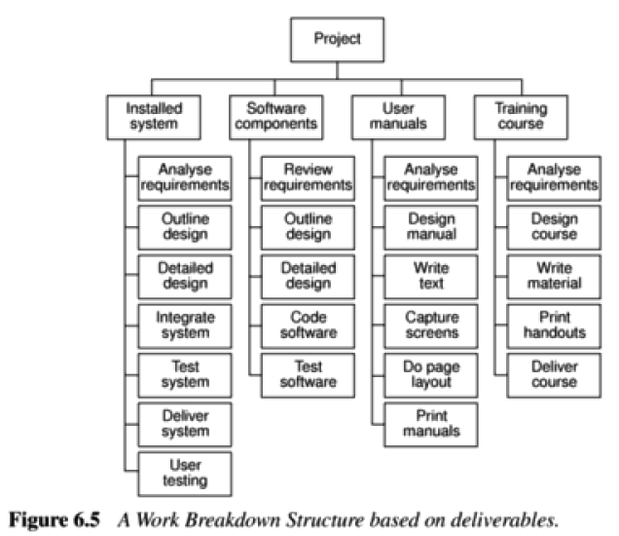
Hybrid Approach

Slide 10
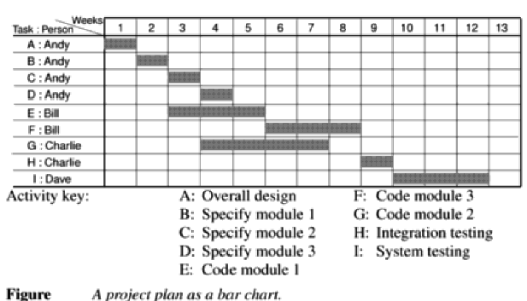
Sequencing And Scheduling Activities
Through out a project, schedule is required that clearly indicates when each of the project’s activities is planned to occur and what resources it needs
Such a plan is presented using a bar chart

Slide 11
Network Planning Models
Critical Path Method (CPM)
Project Evaluation and Review Technique (PERT)
Both provides user with project management tools to plan, monitor and update their project as it progresses
Similarities Between CPM and PERT
Follow the same steps and use network diagrams
Used to plan the scheduling of individual activities that make up a project
Can be used to determine the earliest/latest start and finish times for each activity

Slide 12
Differences Between CPM and PERT
PERT is probabilistic whereas CPM is deterministic
In CPM, estimates of activity duration are based on historical data
In PERT, estimates are uncertain and we talk of ranges of duration and the probability that an activity duration will fall into that range
In routine projects where estimated time for each activity is known, CPM is a better tool to control both time and cost

Slide 13
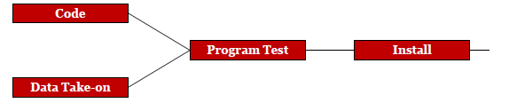
Formulating A Network Model
Represent the activities and their inter-relationships as graph
Activity Network Rules and Conventions (Creating Precedence Network)
A project network should have only one start node and only one end node
A node has duration
Links normally have no duration
Precedents are the immediate preceding activities

Slide 14
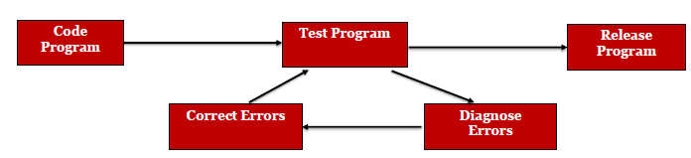
Activity Network Rules and Conventions (Creating Precedence Network)
Time moves from left to right
A network may not contain loops

Slide 15
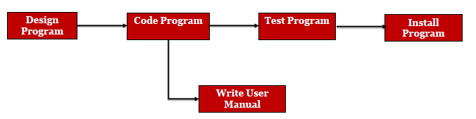
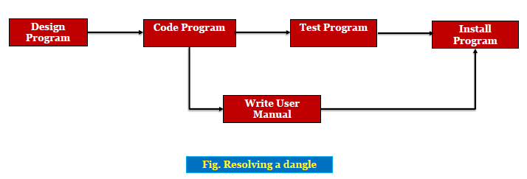
Activity Network Rules and Conventions (Creating Precedence Network)
A network should not contain dangles

Slide 16
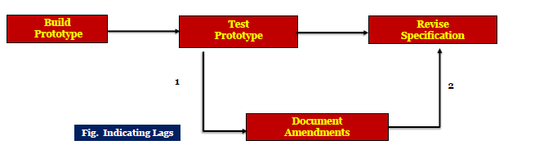
Activity Network Rules and Conventions (Creating Precedence Network)
Representing Lagged Activities

Slide 17
Forward Pass Rule
Earliest start date for an event is the earliest finish date for all the activities terminating at the event
When more than one activity terminates at a common event, take the latest of the earliest finish dates for those events
Backward Pass Rule
Latest date for an event is the latest start date for all the activities that may commence from that event
When more than one activity commences at a common event, take the earliest of the latest start dates for those events

Slide 18
Identifying Critical Path
Slack Time
Difference between the earliest date and latest date for an event
The critical path is the path joining all the nodes with a zero slack

Slide 19
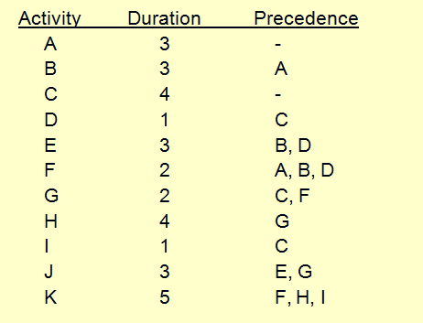
Schedule Representation
Critical Path Method (CPM)

Slide 20
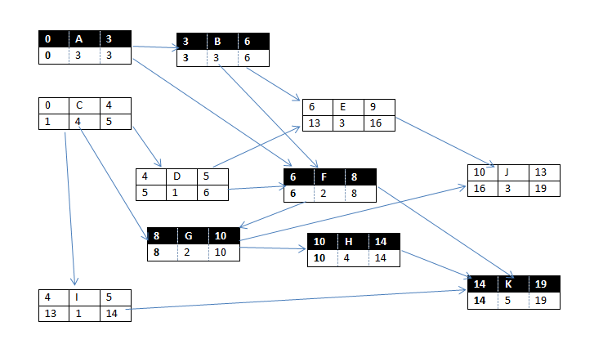

Slide 21
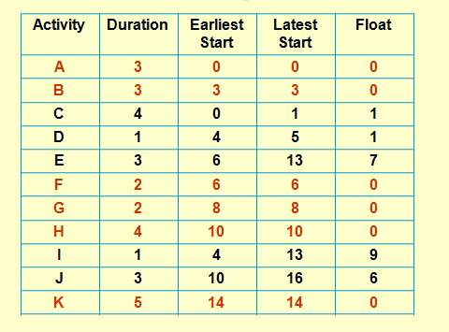
Critical Path Method (CPM)

Slide 22
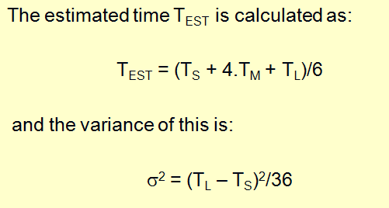
PERT Chart (Project Evaluation Review Technique)
Graphical model that depicts a project’s tasks and relationships between those tasks
Three time estimates optimistic, most likely, pessimistic

Slide 23
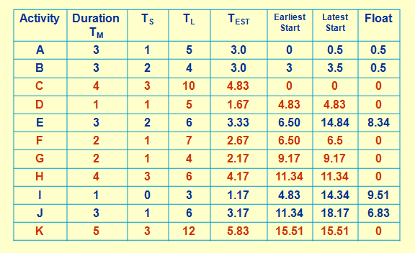
PERT Chart (Project Evaluation Review Technique)

Slide 24
